Slide 1
CS 133G: Beginning C++ for Games
Introduction

Slide 2
About Me
Software developer for over fifteen years
Contract C++ programming for Intel, Nike, Tektronix, ESI, and other Portland area companies
Software development business: Creative CyberSolutions
Third year teaching at LCC
Household
Wife
Daughter
Ten chickens

Slide 3
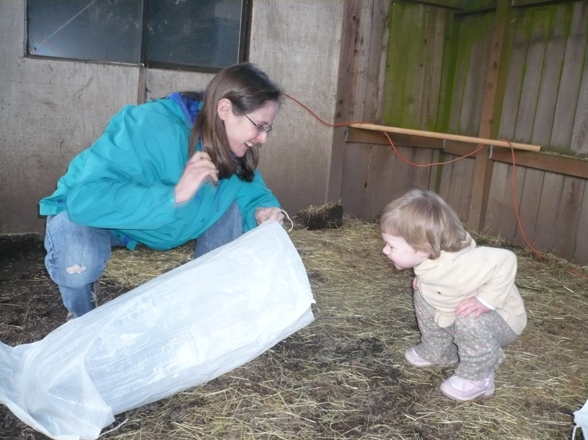
Amanda and Brianna

Slide 4
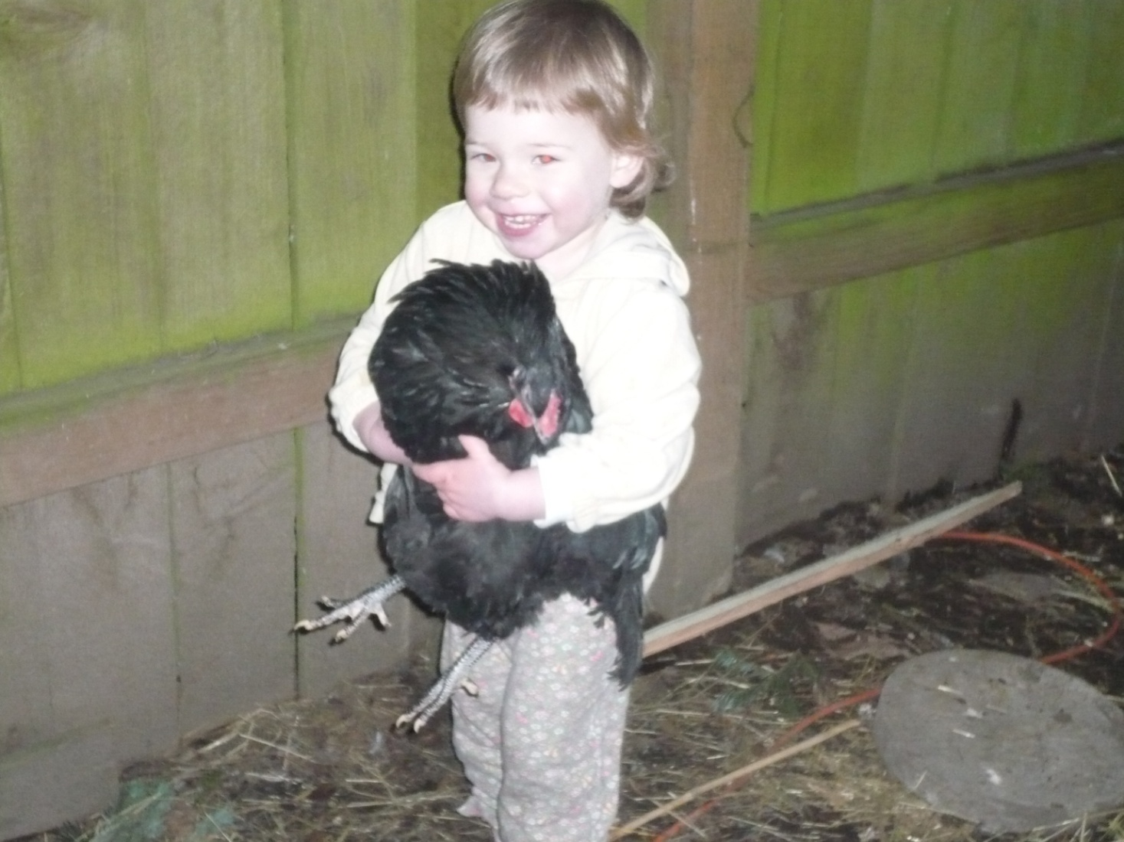
Brianna

Slide 5
About You
How many CIS majors?
How many have written a computer program?
What language did you use?
What do you want to be able to do after you finish this class?

Slide 6
Course Content
Computer Architecture and Programming
Hardware
Software
Compiling and linking a program
C++ Essentials
Just enough to write the most simple programs.
Machine Representation of Data
Number systems
Encoding of text and multimedia
Algorithm and Program Design
What to do before you start coding
Decisions
if
else
switch
Looping
while
for
Functions
How to divide and conquer
Classes and objects
Data structures
Objects contain data and functions

Slide 7
Course Resources
Moodle
Syllabus
Textbooks
Starting Out with C++, Early Objects. 7th ed. Gaddis, Walters, and Muganda
Simple Program Design, A Step-by-Step Approach. 5th ed., Lesley Anne Robertson
Code::Blocks
CIT lab and tutors

